Slide 1
Twitter Big Data Analytics
Using Spark
TEAM 16:
Sai Sriharsha Sudulaguntla (16233059) Lava kumar Surparaju (16233423) Sai Mohith Reddy Chagamreddy(16233203) Avinash Sankarasetty (16233012)

Slide 2
This Project is about analyzing big data collected from Social Networking Sites; we Selected Twitter as our platform, Politics as our topic. Using apache spark for quick analysis of big data we collected twitter data on #ElectionNight. Analyzed the extracted data using spark RDD and Data frames and meaningful data is extracted.
Project Specs: Faster execution than Hadoop Map Reduce in Memory.

Slide 3
Software Design:
Tweets are extracted using API by running python program using the twitter tokens. The collected tweets are stored in JSON format.
On the twitter JSON data, Spark RDD and Data frames analytical queries are run on IntelliJ IDE, Eclipse IDE using Scala plug-ins. Outputs are stored in .csv Files.
Software Requirements: Apache Spark V 1.6,Apache Hadoop V 2.6, JDK 1.8, Scala V 2.11, IntelliJ Idea, Eclipse IDE.
Programming Languages Used: Scala, Python, HTML, JavaScript, SQL.

Slide 4
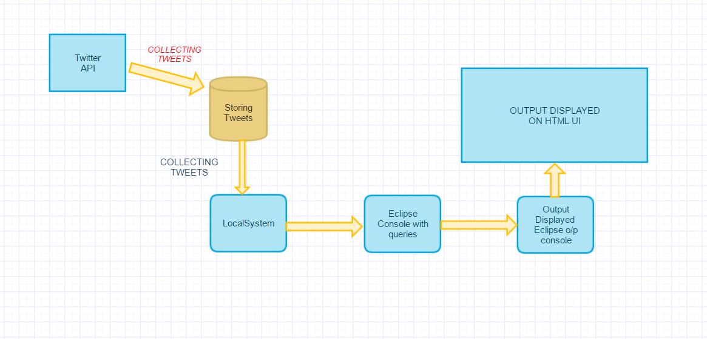
System Architecture:

Slide 5
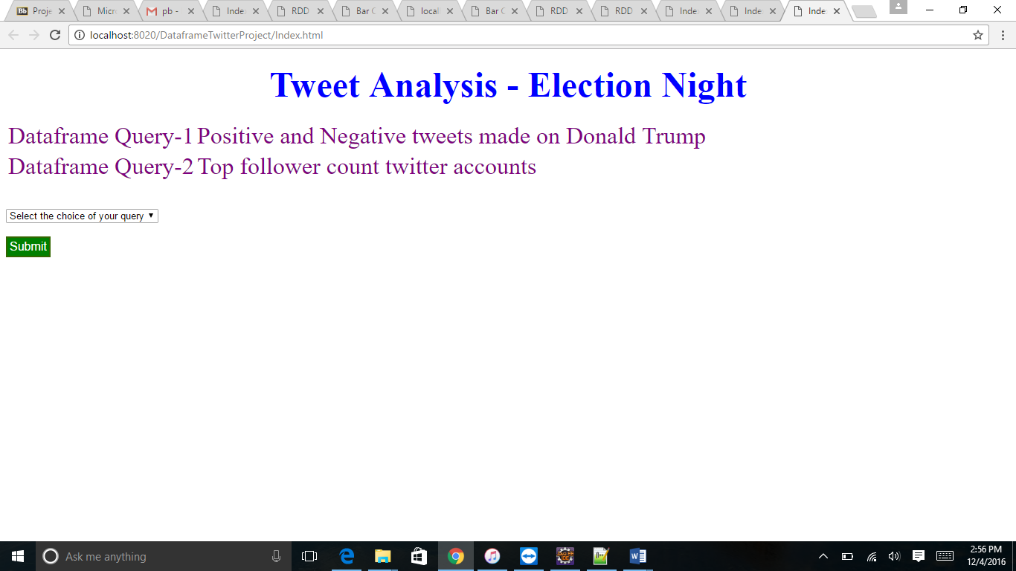
Dynamic Web Application Using Servlets(Extra Credit):

Slide 6
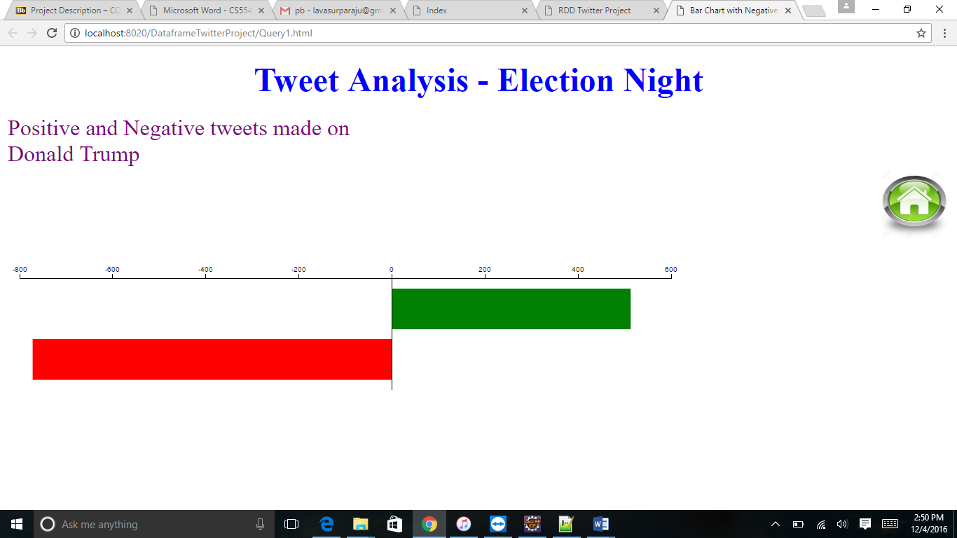
DataFrame Query 1 Visulization. Sentiment Analysis on Tweets made on Trump.

Slide 7
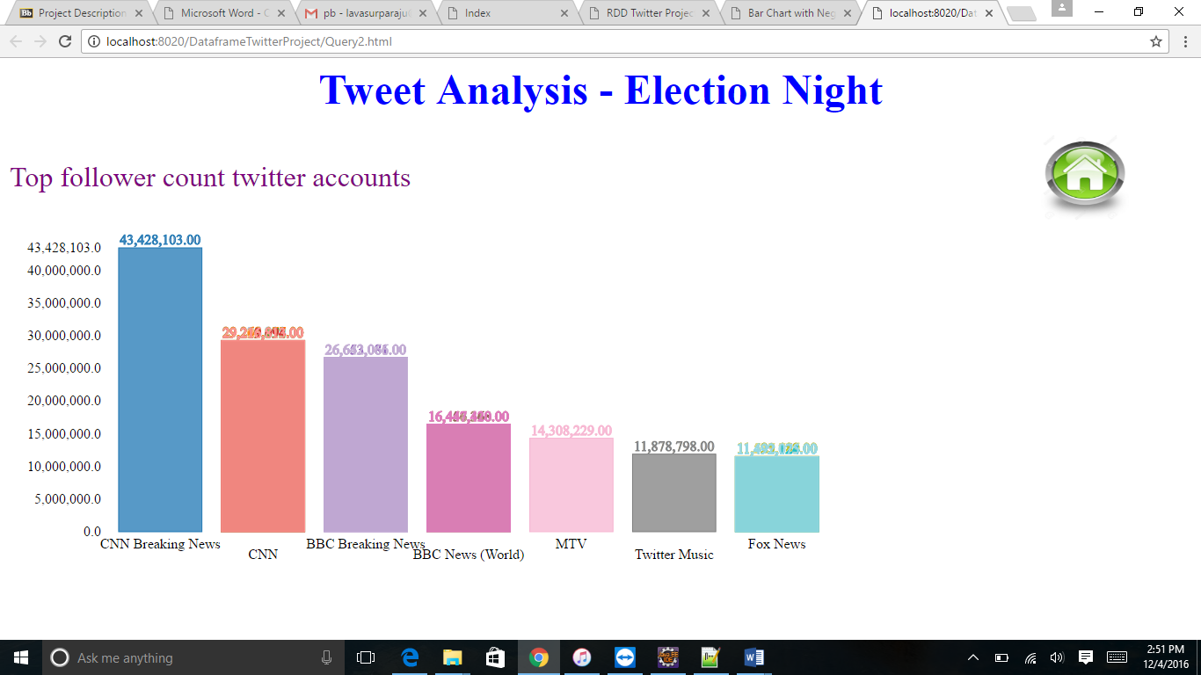
DataFrame Query 2 Visulization. Tweeted Users having Highest Followers.

Slide 8
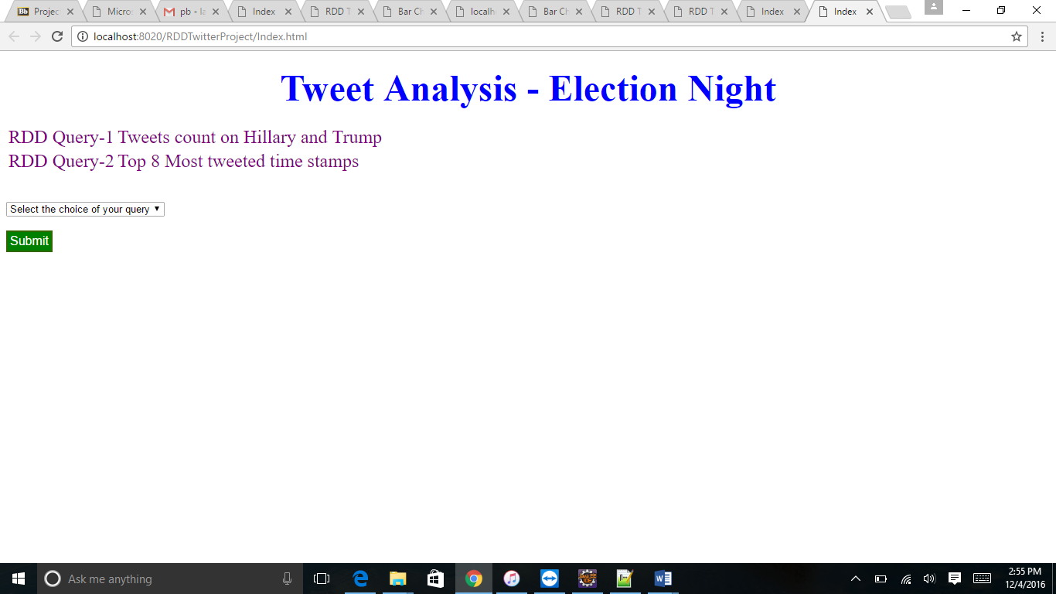
Dynamic Web Application for RDD Queries.

Slide 9
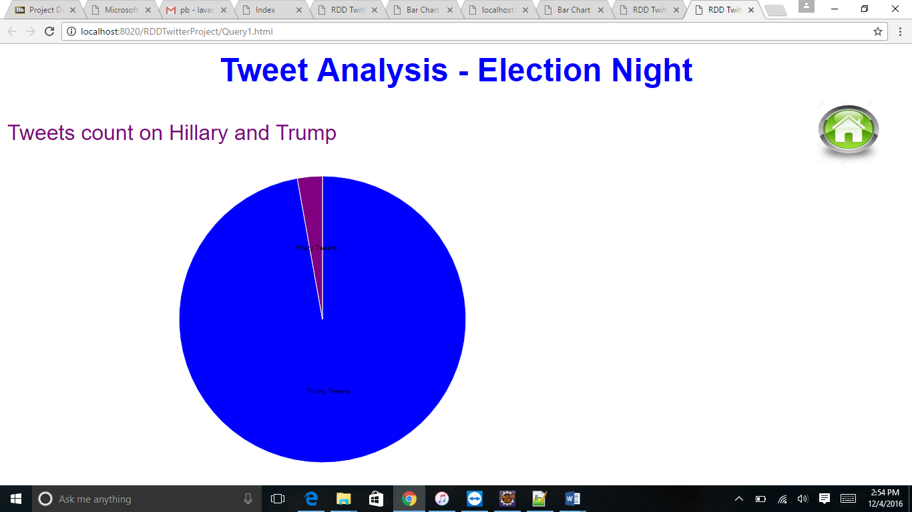
RDD Query 1 Visulization. Pie Chart Showing number of Tweets in which “Hillary”, “Trump” are mentioned.

Slide 10
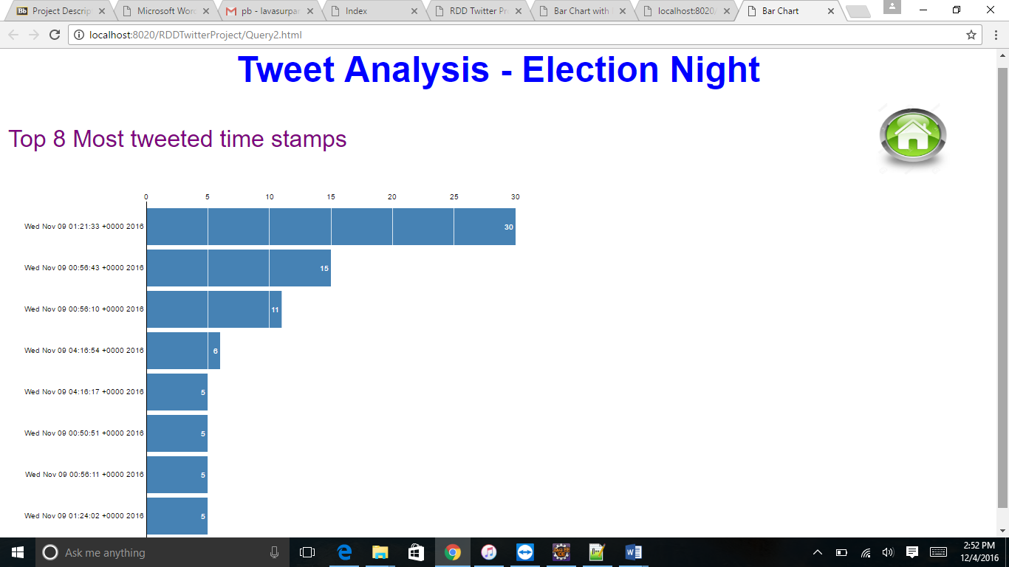
RDD Query 2 Visualization: Most Tweeted Time Stamps Mentioning “Hillary”:

Slide 11
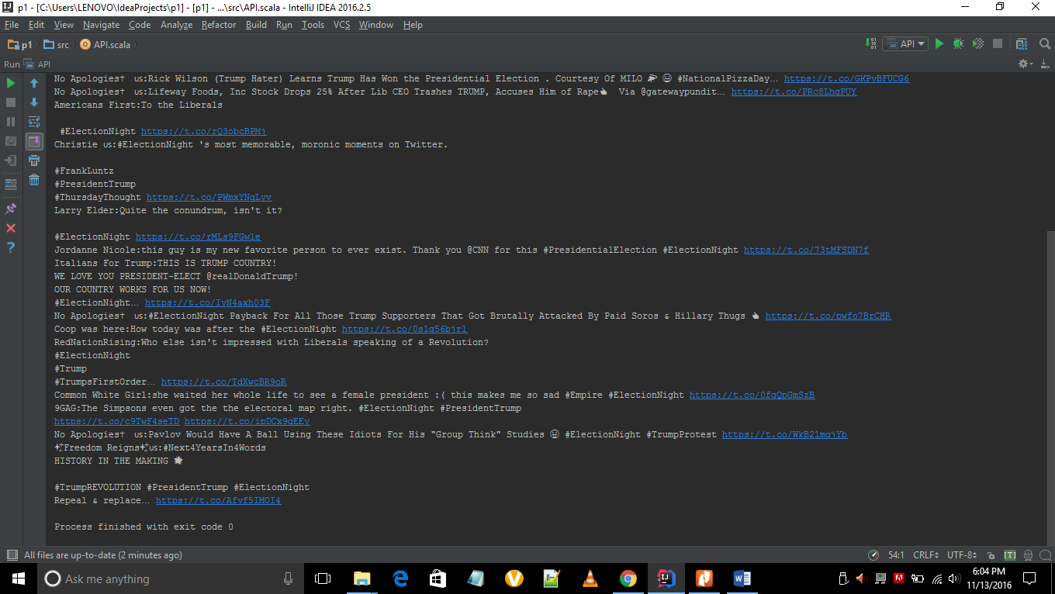
Public API. User’s Favorite Tweets.

Slide 12
Youtube Video Link: https://github.com/SAISRIHARSHAS/PBM2016

